Slide 1
Deenbanbhu Chhotu Ram University of Science and technology
Project Report
Corrosion Protection of Metals
Submitted to : Mr. Yashwant Verma
Designation: Assistant Professor
Presented by :
RAJAT
Roll No.: 17001005046
Chemical Engineering

Slide 2
Outline
Impact of corrosion
Basics of corrosion
Factors affecting corrosion
Methods of preventing corrosion
Motivation
Synthesis of Polyaniline
Corrosion measurement study
Conclusion
Future Aspects
Acknowledgement
References

Slide 3
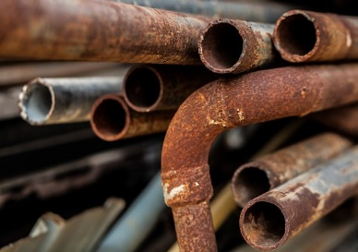

Impact of corrosion
Huge loss to human life and property
Economic losses of the country
Loss of national productivity in replacing deteriorating
bridges and highway infrastructure
Deterioration of natural and historic monuments
Damage to commercial utility infrastructure such as airplanes, vehicles etc.
Rising level of water leaks increased pumping costs and water quality deterioration

Slide 4
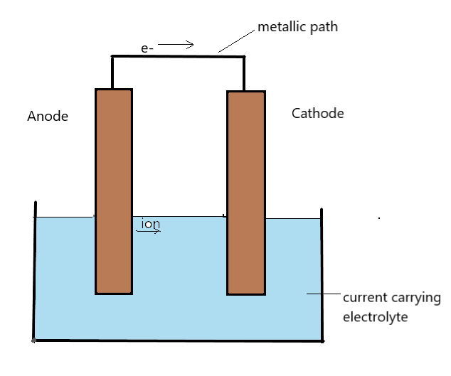
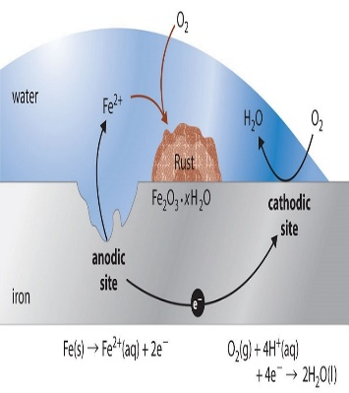
Corrosion
Deterioration of a material by environmental interactions.
Natural phenomenon, requiring three conditions:
moisture,
metallic surface, and
oxidizing agent known as an electron acceptor.
Converts reactive metal into its Schematic representation of electrolytic cell
stable form i.e. either oxide, hydroxide or sulphide.
- Electrochemical process.
Anodic process: Fe → Fe²⁺ + 2e⁻
Cathodic process:
reduction of oxygen gas O₂ + 2H₂O + 4e⁻ → 4OH⁻
reduction of protons H⁺ + e⁻ → ½ H₂(g)
Corrosion cell reduction of metal ion M²⁺ + 2e⁻ → M(s

Slide 5
Factors affecting corrosion
Exposure of the metals to air containing gases like CO_{2,} SO_{2,} SO₃ etc.
Exposure of metals to moisture especially salt water (which increases the rate of corrosion).
Presence of impurities like salt (e.g. NaCl).
An increase in temperature increases corrosion.
Nature of the first layer of oxide formed: some oxides like Al₂O₃ forms an insoluble protecting layer which can prevent further corrosion. Others like rust easily crumble and expose the rest of the metal.
Presence of acid in the atmosphere: acids can easily accelerate the process of corrosion.

Slide 6
Corrosion Prevention
There are various methods from which corrosion can be prevented.
(i) Metal Type: One simple way to prevent corrosion is to use a corrosion resistant metal such as aluminium or stainless steel. Depending on the application, these metals can be used to reduce the need for additional corrosion protection.
(ii) Protective Coatings: The application of a paint coating is a cost-effective way of preventing corrosion. Paint coating act as a barrier to prevent the transfer of electrochemical charge from the corrosive solution to the metal underneath.
Another possibility is applying a powder coating. In this process, a dry powder is applied to the clean metal surface. The metal is then heated which fuses the powder into a smooth unbroken film. A number of different powder compositions can be used, including acrylic, polyester, epoxy, nylon and urethane.
(iii) Environmental Measures: Corrosion is caused by a chemical reaction between the metal and gases in the surrounding environment. By taking measures to control the environment, these unwanted reactions can be minimized. This can be as simple as reducing exposure to rain or seawater, or more complex measures, such as controlling the amount of sulphur, chlorine, or oxygen in the surrounding environment. An example of this would be treating the water in water boilers with softeners to adjust hardness, alkalinity or oxygen content.

Slide 7
(iv) Sacrificial Coatings: Sacrificial coatings involves coating the metal with an additional metal type that is more likely to oxidise; hence the term sacrificial coating.
There are two main techniques for achieving sacrificial coating: cathodic protection and anodic protection.
Cathodic Protection: The most common example of cathodic protection is the coating of iron alloy steel with zinc, a process known as galvanising. Zinc is a more active metal than steel, when it starts to corrode its oxide which inhibit the corrosion of the steel. This method is known as cathodic protection because it works by making the steel the cathode of an electrochemical cell. Cathodic protection is used for steel pipelines carrying water or fuel, water heater tanks.
Anodic Protection: Anodic protection involves coating the iron alloy steel with a less active metal, such as Tin. Tin will not corrode, so the steel will be protected as long as the tin coating is in place. This method is known as anodic protection because it makes the steel the anode of an electrochemical cell.
V) Corrosion inhibitors: Corrosion inhibitors are chemicals that react with the surface of the metal or the surrounding gases to suppress the electrochemical reactions leading to corrosion. Their work is being applied to the surface of a metal where they form a protective film. Inhibitors can be applied as a solution or as a protective coating using dispersion techniques. Corrosion inhibitors are commonly applied via a process known as passivation. In passivation, a light coat of a protective layer over the metal which against as a barrier against corrosion. The formation of this layer is affected by environmental pH, temperature and surrounding Chemical composition.
(vi) Design Modification: Design modifications can help reduce corrosion and improve the durability of any existing protective anti corrosive coatings. Ideally, design should avoid trapping dust and water, encourage movement of air, and avoid open cervices. Ensuring the metal is accessible for regular maintenance will also increase longevity.

Slide 8
Motivation
Why polyaniline?
Conducting polymer are also known as aniline black.
Cheap and easy availability of its monomer
Easily synthesized chemically or electrochemically
Simple doping and de-doping chemistry
Chemical and environmental stability
Electroactive in nature
Electrical conducting due to the delocalization of electrons
Reduction potential – 0.6 -1.0V
Exist in three different redox states i.e.
- Leucoemeraldine (completely reduced form) – white /clear or colorless
- Emeraldine (half –oxidized) – green for emeraldine salt/ blue for emeraldine base
- Pernigraniline (fully oxidized) – blue / violet
Effective in preventing metallic corrosion
- immense surface ennobling by formation of a passivating metal oxide
Highly compatible with organic topcoats (epoxy based coatings and polyurethane based coatings)
Aniline
Polyaniline

Slide 9
Mechanism of prevention of corrosion by polyaniline
^{In case if iron;}
Fe → 2e⁻ + Fe²⁺ → Fe(OH)₂ → Fe₂O₃
2H₂O + O₂ → 4OH⁻
Passive
PANI protects via anodic protection and the controlled inhibitor release mechanism by the formation of iron oxide and is facilitated when PANI is reduced and dopant anion is released due to the initiation of pitting corrosion

Slide 10
Synthesis of polyaniline
PANI was prepared through direct route using HCl as the dopant by free radical Chemical oxidative Polymerisation.
0.1 mol of freshly distilled aniline was dissolved in the aqueous solution of 1.0M HCl.
The above mixture was stirred continuously and the polymerisation was initiated by the addition of the 0.1 mol of (NH₄)₂S₂)₈ in 150mL of distilled water.
This reaction was carried at very low temperature i.e. (0+0.1) with continuous study for 6hrs.
The polymer was produced directly in the doped state as fine slurry of dark green particles.
The reaction mixture was filtered and washed repeatedly with distilled water until filtrate become colourless.
The obtained product was dried at 60 under dynamic vacuum.
The dried mass was crushed to obtain the powder of the doped PANI (emeraldine salt) designated as PANI.

Slide 11
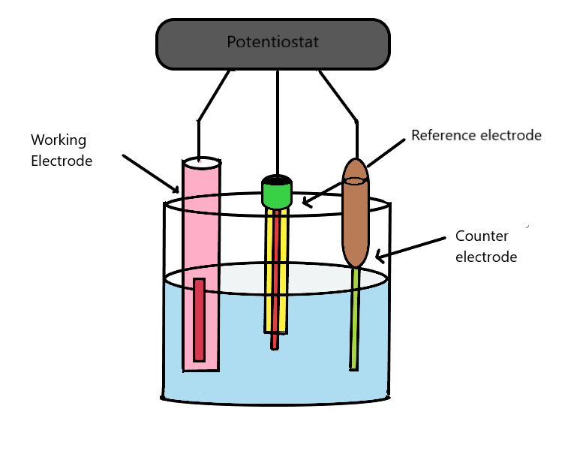
Corrosion measurement study
Corrosion measurement study can be performed
at room temperature by three electrode cell assembly
using Autolab Potentiostat (Nova software).
The techniques involved in the corrosion measurement are
Electrochemical Impedance Spectroscopy (EIS),
Tafel Polarization Method,
Linear Polarization Resistance (LPR) Method,
Weight loss method.
Schematic diagram of test cell used in a typical electrochemical corrosion measurement

Slide 12
Conclusion
Polyaniline(PANI) can be used as the coating to prevent the surface of the metal from undergoing corrosion.

Slide 13
Future aspects
Analysis of the Polyaniline by the various spectroscopical method such as Fourier transfer Infrared Spectroscopy, UV Visible spectroscopy, X-Ray Diffraction, Raman spectroscopy and SEM.
Synthesis of the Composites of the polyaniline in order to make it better resistant to the corrosion
Composites can be made by varying the ratios and further the corrosion measurement study can be performed.

Slide 14
Acknowledgement
I would like to express my profound gratitude and deep regards to my guide Mr. Yashwant Verma for his exemplary guidance, monitoring and constant encouragement throughout the course of my project work, for his expertise in the field of chemical engineering and for having faith in me at every stage of my research.

Slide 15
References
R. CruzSilva, J. RomeroGarcia, J. L. Angulo Sanchez, A. LedezmaPerez, E. AriasMarin, I. Mog gio, and E. FloresLoyola, Eur. Polym. J. 41, 1129 (2005).
A. V. Karamyshev, S. V. Shleev, O. V. Koroleva, A. I. Yaropolov, and I. Yu. Sakharov, Enzyme Microb. Technol. 33, 556 (2003).
W. Li, M. Zhu, Q. Zhang, and D. Chen, Appl. Phys. Lett. 89, 103 (2006). 82. J. E. Yoo, J. L. Cross, T. L. Bucholz, K. S. Lee, M. P. Espe, and Y.L. Loo, J. Mater. Chem. 17, 1268 (2007).
I. P. Men’shikova, O. A. Pyshkina, E. A. Men’shikov, E. N. Nasybulin, K. A. Milakin, K. Levon, and V. G. Sergeev, Polym. Sci., Ser. A 51 (6), 1008 (2009).
I. P. Men’shikova, O. A. Pyshkina, K. Levon, and V. G. Sergeev, Colloid J. 71 (2), 243 (2009).

